Slide 1


HOUSING PRICE PREDICTION PRESENTATION
Under the Supervision of
Mr. Shwetank Mishra
Presented By :- Suneel Kumar

Slide 2
AGENDA
Introduction​
Problem Statement
Objective
Exploratory Data Analysis (EDA)
Visualization
Inference
Future Work​
Summary​

Slide 3
Introduction
PROBLEM STATEMENT:
Houses are one of the necessary need of each and every person around the globe and therefore housing and real estate market is one of the markets which is one of the major contributors in the world’s economy. It is a very large market and there are various companies working in the domain. Data science comes as a very important tool to solve problems in the domain to help the companies increase their overall revenue, profits, improving their marketing strategies and focusing on changing trends in house sales and purchases. Predictive modelling, Market mix modelling, recommendation systems are some of the machine learning techniques used for achieving the business goals for housing companies. Our problem is related to one such housing company. A US-based housing company named Surprise Housing has decided to enter the Australian market. The company uses data analytics to purchase houses at a price below their actual values and flip them at a higher price. For the same purpose, the company has collected a data set from the sale of houses in Australia.
The company is looking at prospective properties to buy houses to enter the market. You are required to build a model using Machine Learning in order to predict the actual value of the prospective properties and decide whether to invest in them or not and the data is provided in the CSV file. For this company wants to know:
Which variables are important to predict the price of variable?
How do these variables describe the price of the house?

Slide 4
Business Goal:
You are required to model the price of houses with the available independent variables. This model will then be used by the management to understand how exactly the prices vary with the variables. They can accordingly manipulate the strategy of the firm and concentrate on areas that will yield high returns. Further, the model will be a good way for the management to understand the pricing dynamics of a new market.

Slide 5
Technical Requirements:
Data contains 1460 entries each having 81 variables.
Data contains Null values. You need to treat them using the domain knowledge and your own understanding.
Extensive EDA has to be performed to gain relationships of important variable and price.
Data contains numerical as well as categorical variable. You need to handle them accordingly.
You have to build Machine Learning models, apply regularization and determine the optimal values of Hyper Parameters.
You need to find important features which affect the price positively or negatively.
Two datasets are being provided to you (test.csv, train.csv). You will train on train.csv dataset and predict on test.csv file.

Slide 6
Exploratory Data Analysis (EDA)
Checking Total Numbers of Rows and Column
Checking All Column Name
Checking Data Type of All Data
Checking for Null Values
Information about Data
Checking total number of unique value
Checking all value of each columns
Handling Null Values

Slide 7
Data Description
The dataset contains 1460 records (rows) and 81 features (columns). Here, we will provide a brief description of dataset features. Since the number of features is large (81), So, we will mention the feature name with a short description of its meaning

Slide 8
DataSet Description
Features with Description: MSSubClass: The type of the house involved in the sale MSZoning: The general zoning classification of the sale LotFrontage: Linear feet of street connected to the house LotArea: Lot size in square feet Street: Type of road access to the house Alley: Type of alley access to the house LotShape: General shape of the house LandContour: House flatness Utilities: Type of utilities available LotConfig: Lot configuration LandSlope: House Slope Neighborhood: Locations within Ames city limits Condition1: Proximity to various

Slide 9
HouseStyle: House style
OverallQual: Overall quality of material and finish of the house
OverallCond: Overall condition of the house
YearBuilt: Construction year
YearRemodAdd: Remodel year (if no remodeling nor addition, same as YearBuilt)
RoofStyle: Roof type
RoofMatl: Roof material
Exterior1st: Exterior covering on house
Exterior2nd: Exterior covering on house (if more than one material)
MasVnrType: Type of masonry veneer
MasVnrArea: Masonry veneer area in square feet
ExterQual: Quality of the material on the exterior
ExterCond: Condition of the material on the exterior
Foundation: Foundation type
BsmtQual: Basement height
BsmtCond: Basement Condition
BsmtExposure: Refers to walkout or garden level walls
BsmtFinType1: Rating of basement finished area
BsmtFinSF1: Type 1 finished square feet
BsmtFinType2: Rating of basement finished area (if multiple types)

Slide 10
BsmtFinSF2: Type 2 finished square feet
BsmtUnfSF: Unfinished basement area in square feet
TotalBsmtSF: Total basement area in square feet
Heating: Heating type
HeatingQC: Heating quality and condition
CentralAir: Central air conditioning
Electrical: Electrical system type
1stFlrSF: First floor area in square feet
2ndFlrSF: Second floor area in square feet
LowQualFinSF: Low quality finished square feet in all floors
GrLivArea: Above-ground living area in square feet
BsmtFullBath: Basement full bathrooms
BsmtHalfBath: Basement half bathrooms
FullBath: Full bathrooms above ground
HalfBath: Half bathrooms above ground
Bedroom: Bedrooms above ground
Kitchen: Kitchens above ground
KitchenQual: Kitchen quality
TotRmsAbvGrd: Total rooms above ground (excluding bathrooms)
Functional: Home functionality
Fireplaces: Number of fireplaces

Slide 11
FireplaceQu: Fireplace quality
GarageType: Garage location
GarageYrBlt: Year garage was built in
GarageFinish: Interior finish of the garage
GarageCars: Size of garage (in car capacity)
GarageArea: Garage size in square feet
GarageQual: Garage quality
GarageCond: Garage condition
PavedDrive: How driveway is paved
WoodDeckSF: Wood deck area in square feet
OpenPorchSF: Open porch area in square feet
EnclosedPorch: Enclosed porch area in square feet
3SsnPorch: Three season porch area in square feet
ScreenPorch: Screen porch area in square feet
PoolArea: Pool area in square feet
PoolQC: Pool quality
Fence: Fence quality
MiscFeature: Miscellaneous feature
MiscVal: Value of miscellaneous feature
MoSold: Sale month
YrSold: Sale year
SaleType: Sale type
SaleCondition: Sale condition

Slide 12
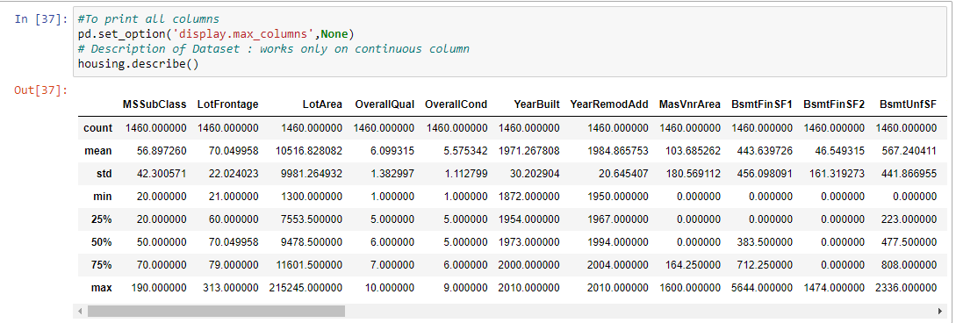
Data Pre-processing

Slide 13
Data Visualization
Univariate Analysis Using Countplot (for categorical data) Using Histplot (for continuous data) 2. Bivariate Analysis (for comparision between features and target) Using Countplot (for comparision between categorical data and target) Using Scatterplot (for comparision between continuous data and target) 3. Multivariate Analysis Using Pairplot (comparision between all continuous features and target)

Slide 14
Encoding
Using Label Encoder: Transformation of all string data from object datatype to Integer datatype.

Slide 15
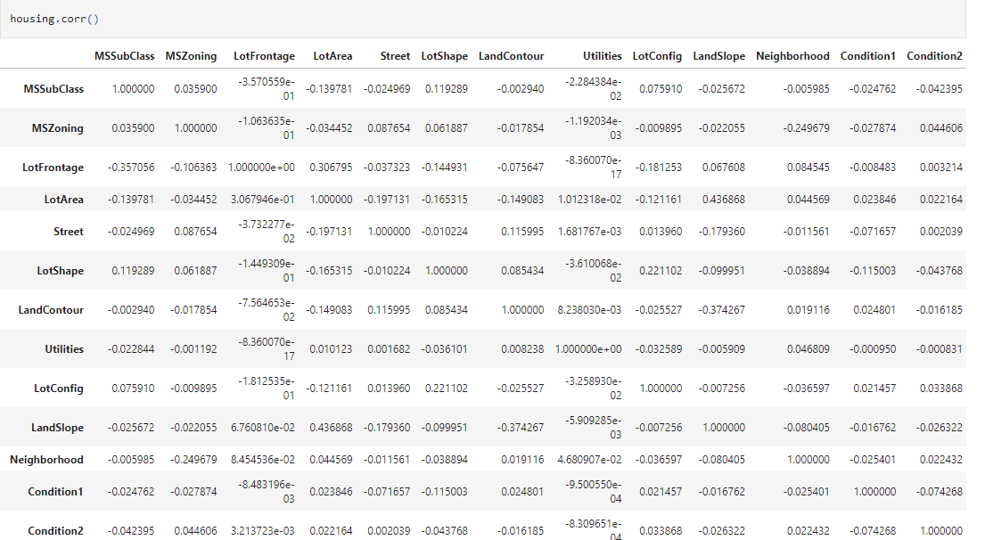
Checking Correlation

Slide 16
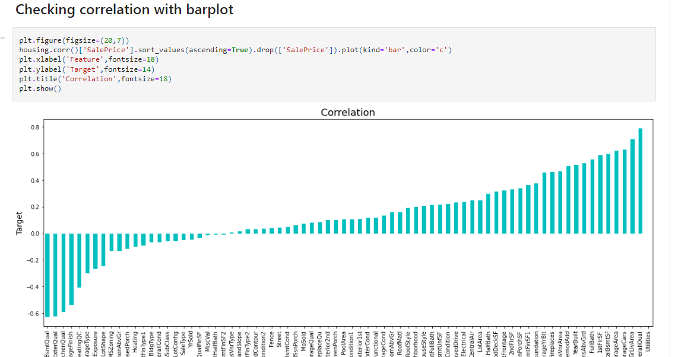
Correlation is checked for relation between the dependent and independent variables. Also Checked through heatmap and BarPlot (Visualization)

Slide 17
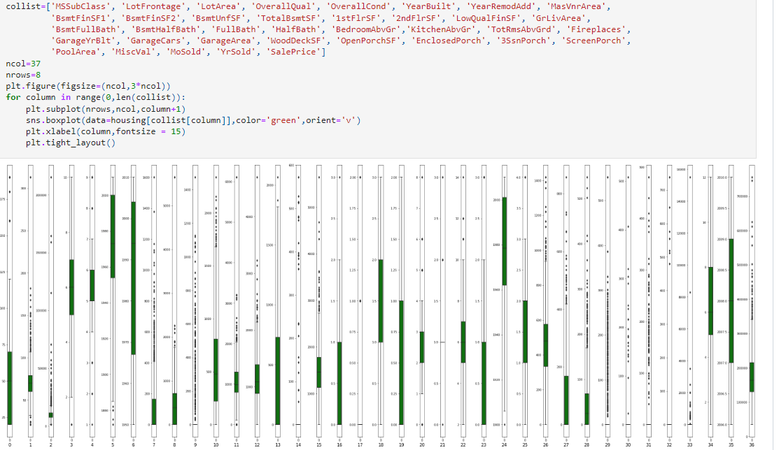
Checking Outliers
Outliers are removed only from continuous features and not from target and categorical features.

Slide 18
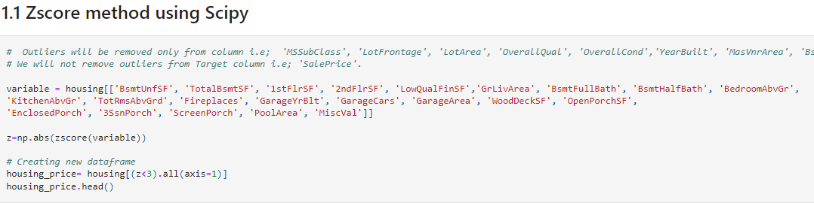
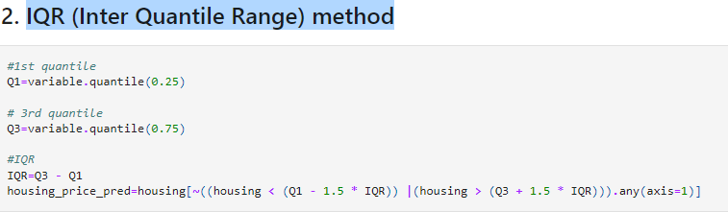
Removing Outliers
Checking two methods and compare between them which is give less percentage loss and then using that method for further process. Zscore method using Scipy IQR (Inter Quantile Range) method

Slide 19
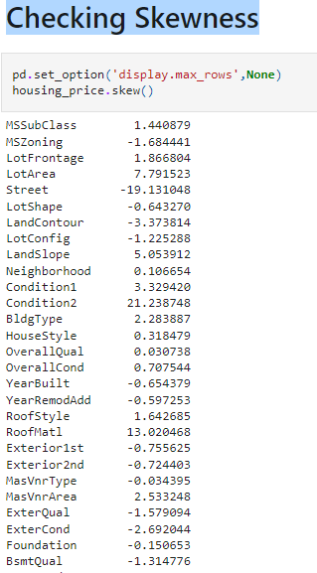
Checking Skewness

Slide 20
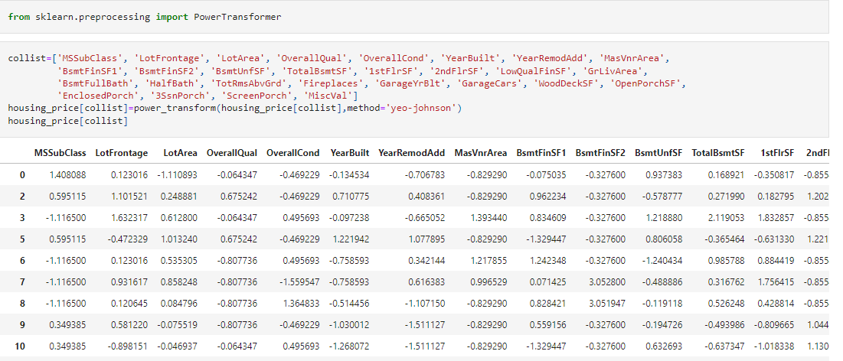
Removing skewness
Using yeo-johnson method

Slide 21
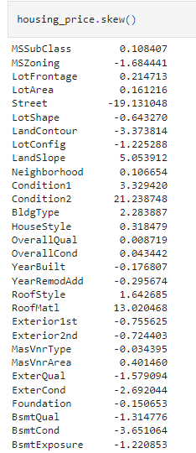
Checking skewness after removal

Slide 22
Checking skewness after removal

Slide 23

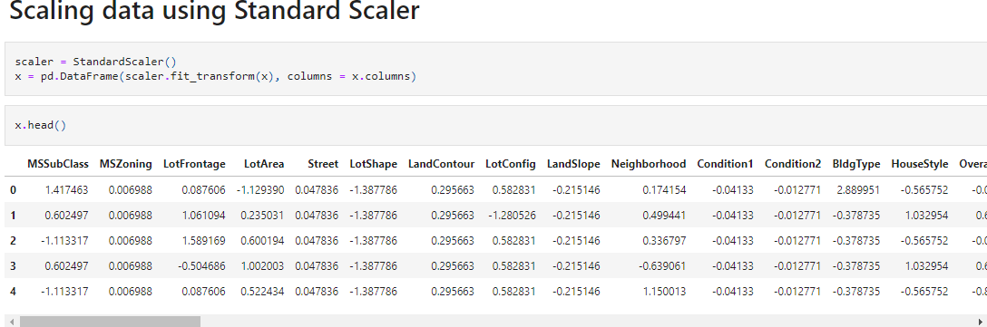

Slide 24
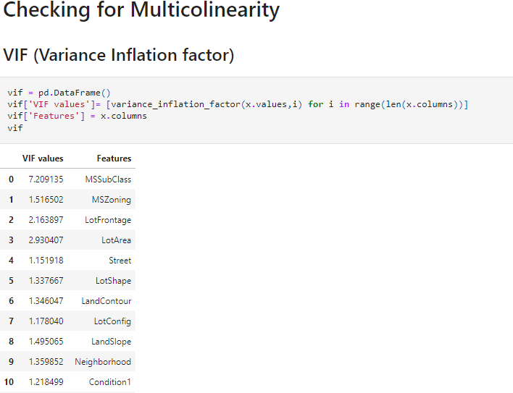

Slide 25
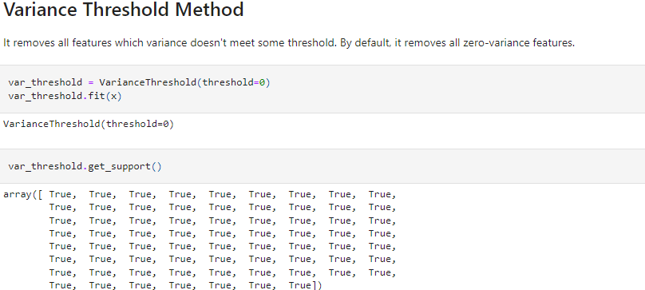
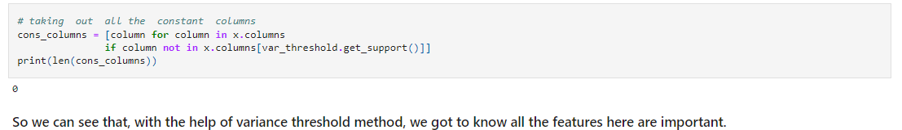

Slide 26
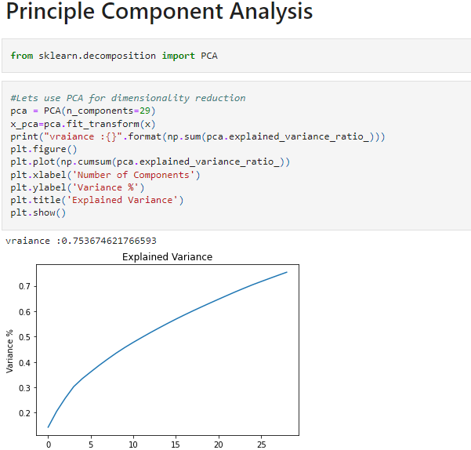

Slide 27
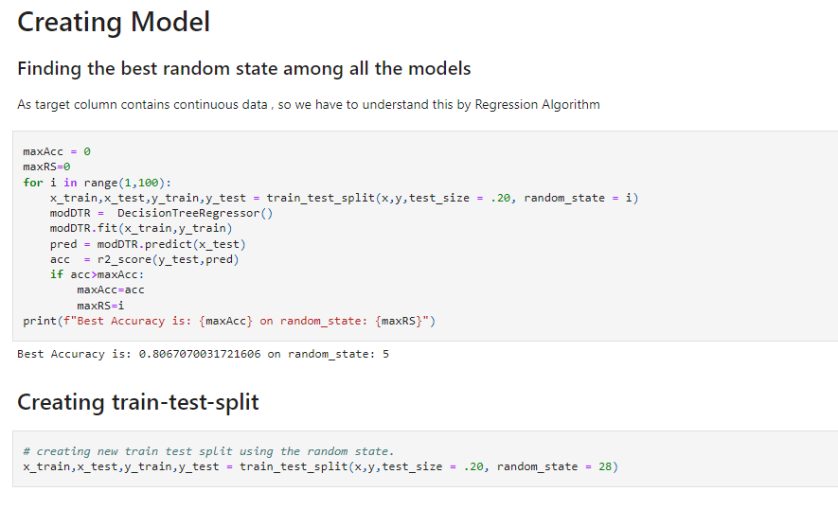

Slide 28
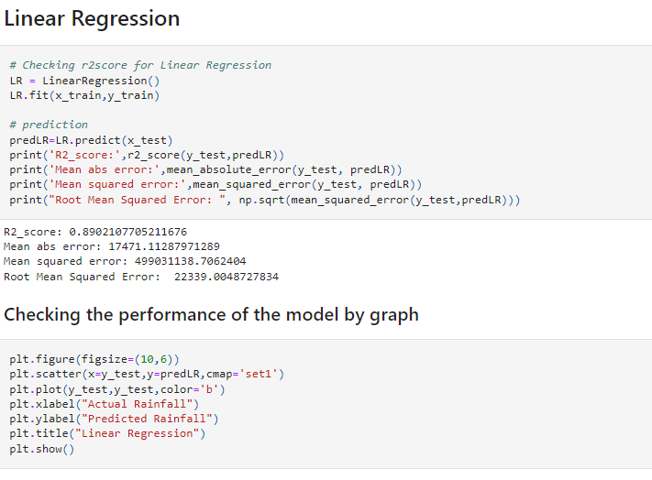
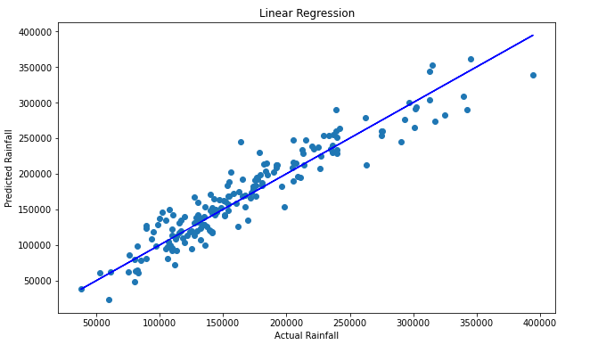

Slide 29
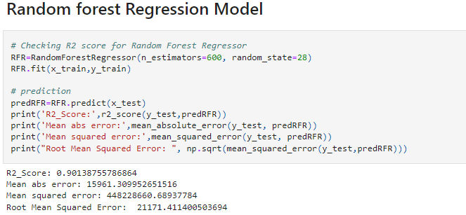
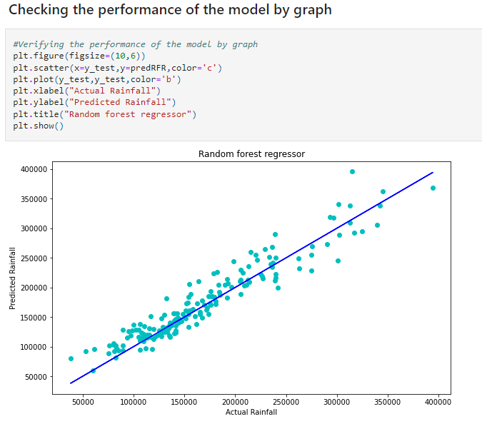

Slide 30
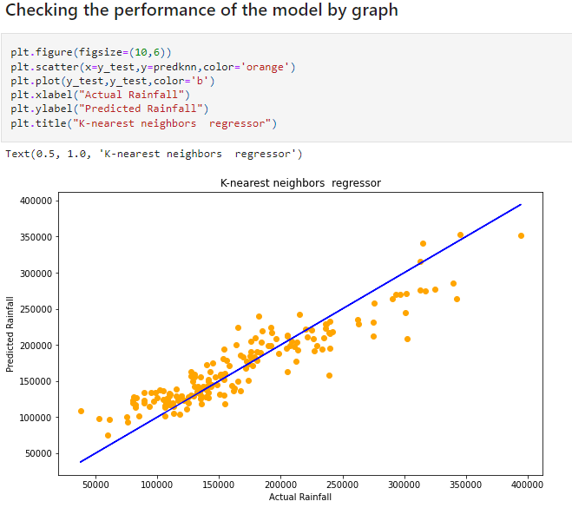
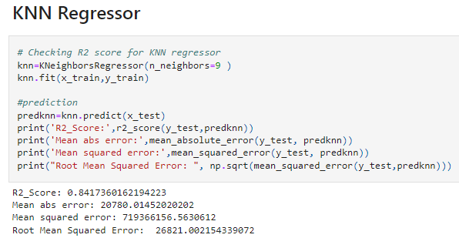

Slide 31
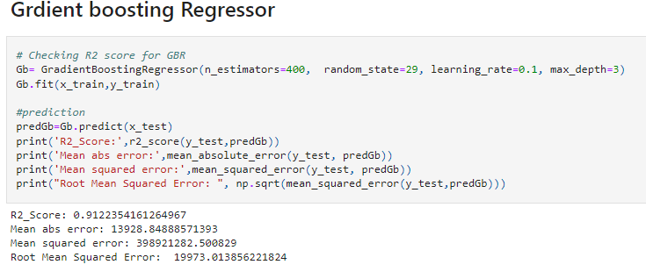
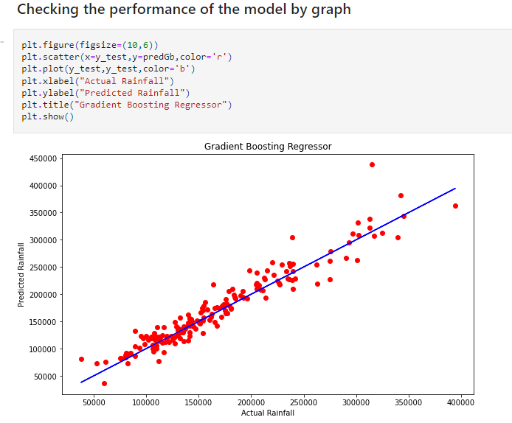

Slide 32
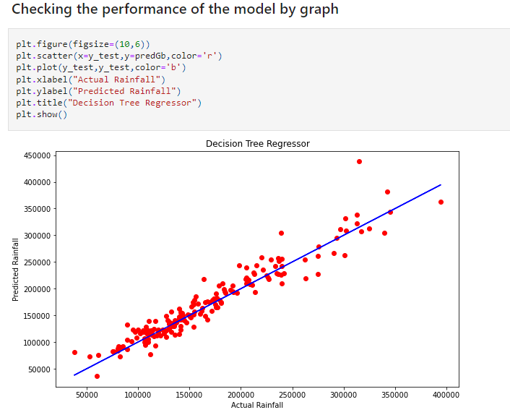
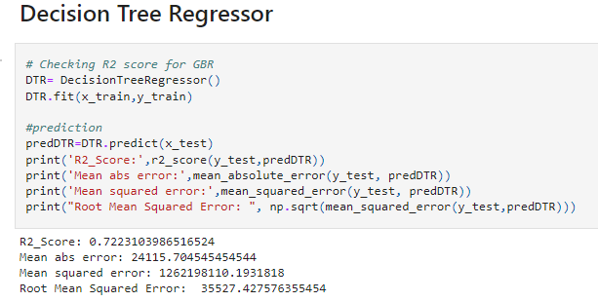

Slide 33
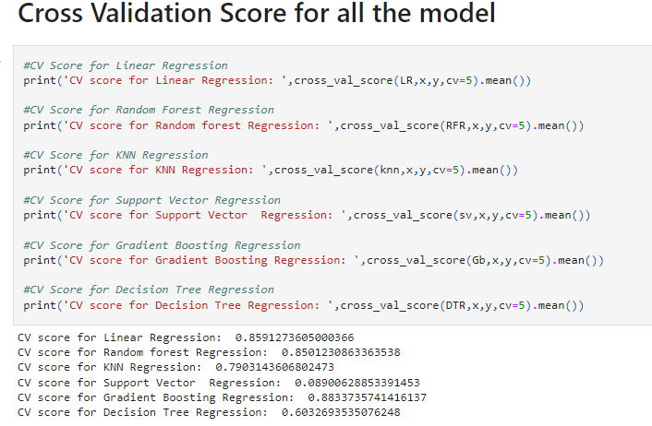

Slide 34
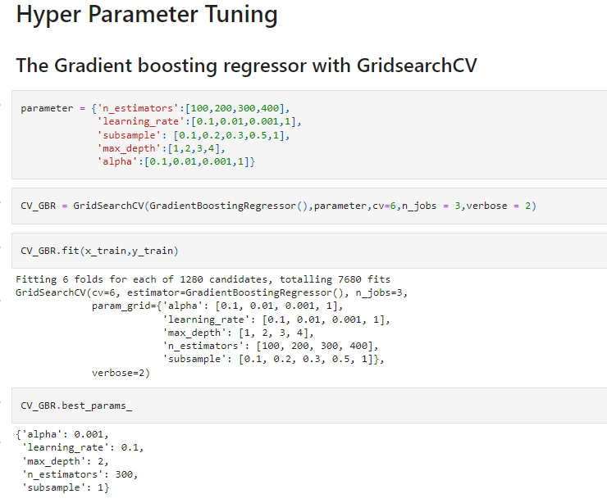

Slide 35
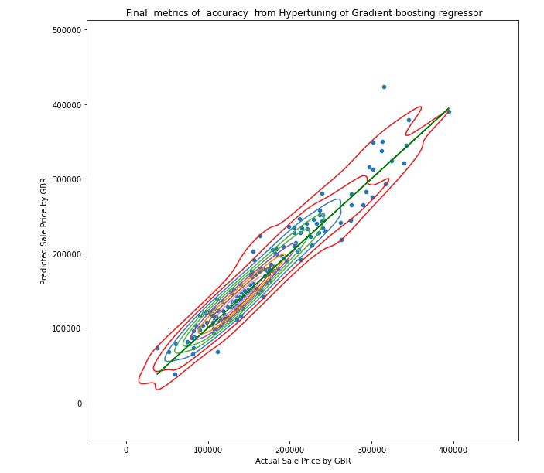
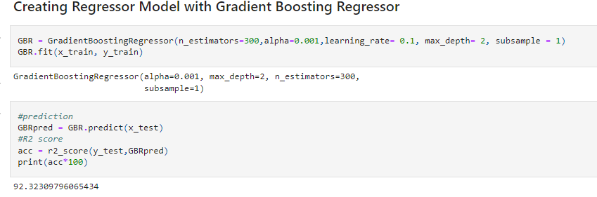
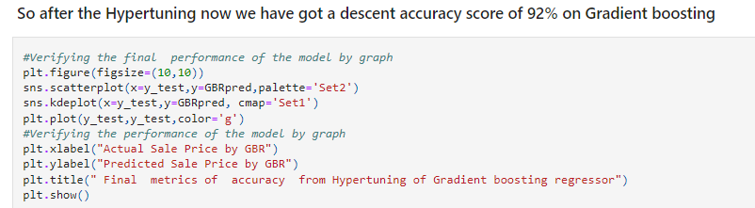

Slide 36
Final Procedure: 1. Saving the model 2. Comparing Actual and Prediction 3. Saving the model in CSV format

Slide 37
SUMMARY
Here we have predicted Sale Price of Houses, We have done prediction of Selling price of houses on basis of Data using EDA, Data Visualization, Data Pre-processing, Checking Correlation, Outliers, Skewness and removed not important features for prediction and at last train our data by splitting our data through train-test split process. Created our model using multiple model and finally selected best model which was giving best accuracy. And at last compared our predicted and Actual Sale Price of Houses. Thus our project is completed.

Slide 38
THANK YOU

